Slide 1
The Study App
An Intuitive Flashcard Application

Slide 2
Goal of the PRoject
The StudyApp is a user built and defined flashcard program that facilitates memorization of study material through appropriately timed review and repetition, guided by a metric that tracks how long a user remembers an answer.
A passion for learning and an understanding that learning and study are both time consuming and difficult. This application is meant to reduce the effort needed to acquire and remember information. The App runs on two premises: 1, that all information can be reduced to a single irreducible point, and those points built upon each other to produce greater levels of information; and 2, the human brain forgets information at particular intervals- when information is reviewed right before the end of this interval, the amount of time the information is retained is doubled.

Slide 3
Requirements
MVP
The bare bones necessary for the basic version of this app is a streamlined user input (to facilitate the digestion of information), and a flashcard program which the user can quiz themselves with.
Full
The full, release ready, version of this application contained:
A user profile for study tracking
Randomized multiple choice answer set on the flashcard. The correct answer is logged and the study interval is increased. An incorrect answer is returned to the deck and reviewed until correct, the interval staying the same.
A Study Score that measures and tracks the user’s rate of remembrance/forgetting
A reminder system that prompts the user to review information the precise moment it is advantageous to review information

Slide 4
Requirements
Stretch
The grand goal of this application is not just to help the user learn, but to map what exactly they know and for how long that information will be instinctually available
A Knowledge Map: academic subjects, intellectual pursuits, career requirements- any discipline that can be viewed as a procedure is incrementalized and summed up. This will allow the user (and anyone the user wishes) to have a visual idea of how much of any given pathway a user knows.
Academia- grade school thru doctorate level information is easily available and tracked. Potential employers will be able to see just how close a user is to a particular degree level of understanding in a given subject
Career- Companies can load coursework that they require any potential candidate to know. This way the interview is purely a ”fit” interview.
Skills- A video tutorial system that users can use to learn hands on skills. In order to progress through these, a user must upload video clips of themselves completing the incremental tasks as they build out their portfolio.

Slide 5
Database Relations
The idea that I started with was that the user would be the primary key for the entire user added db, with each level having its own id for ease in retrieving questions and linking correct answers. As can be seen on the left, that level of organization gets murky, and its translation into C# even murkier. Database issues were the most numerous of problems encountered up til this point. I settled on a simple Term based framework to salvage database functionality for this project. Moving forward, after User Authentication is added, I plan to re-attempt the user centric model.

Slide 6
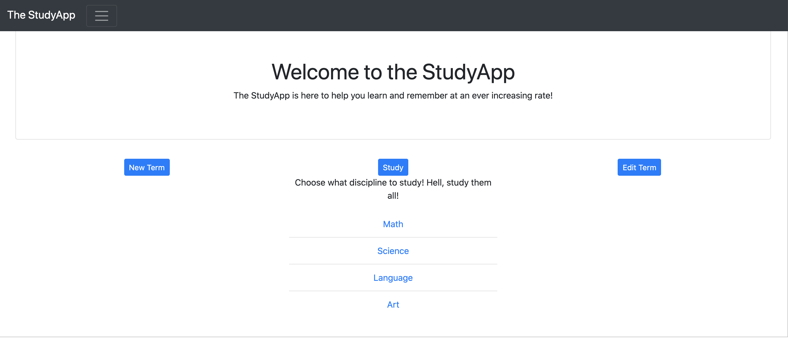
Home SCreen

Slide 7
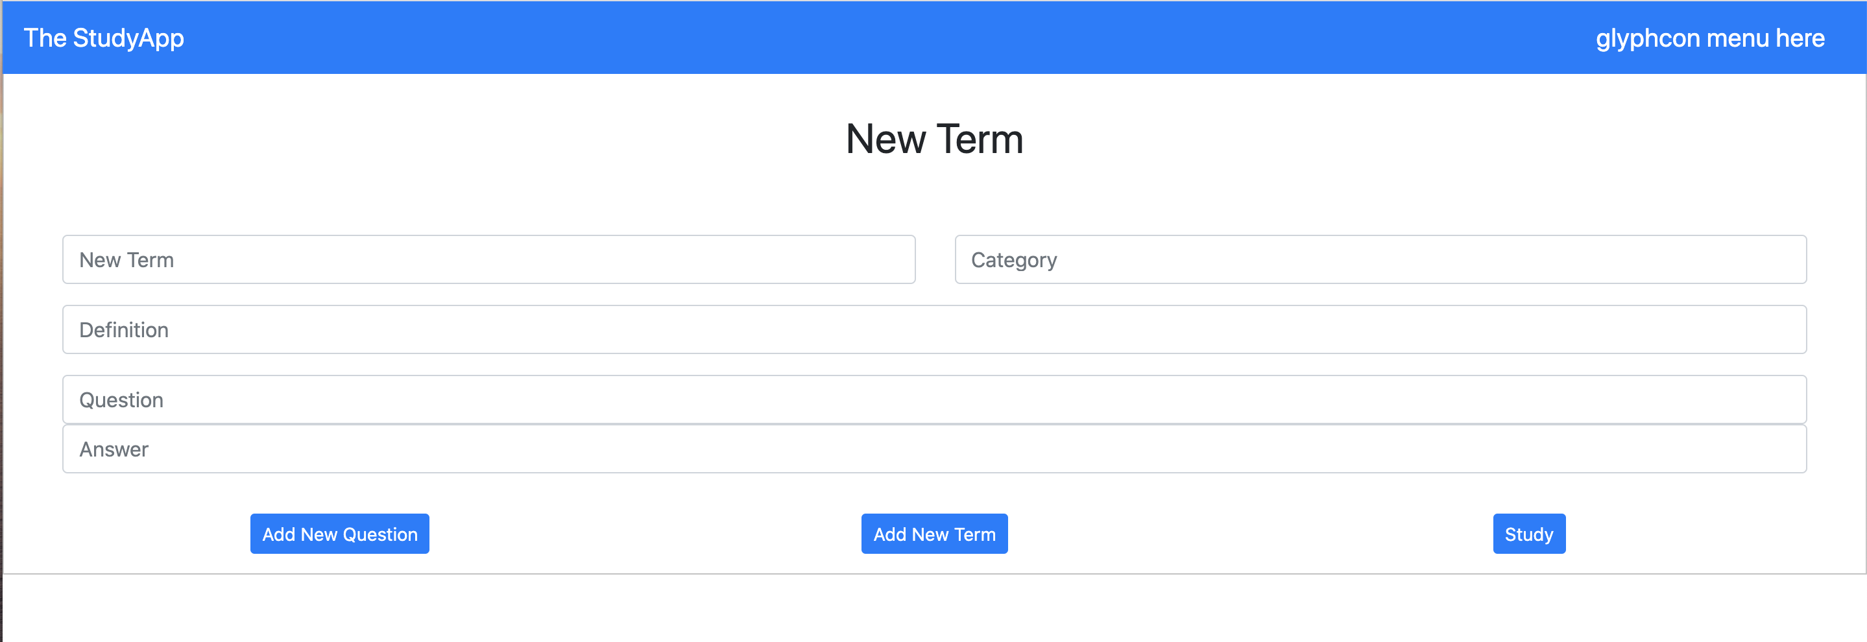
New Term

Slide 8
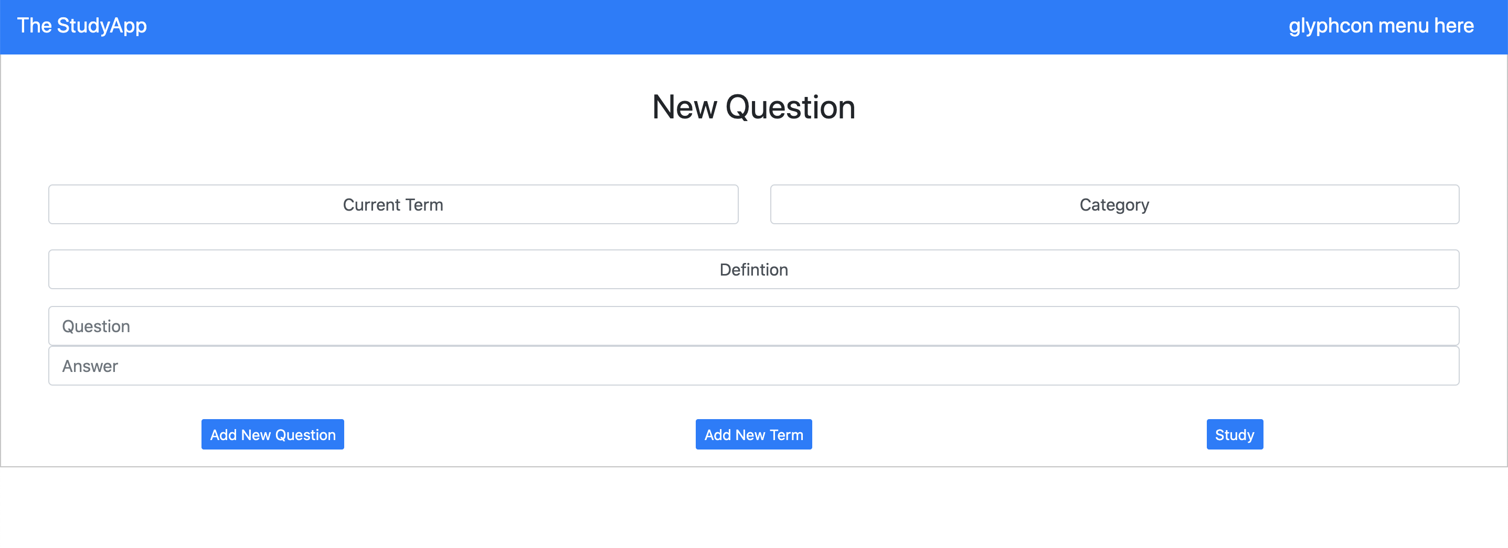
New Question

Slide 9
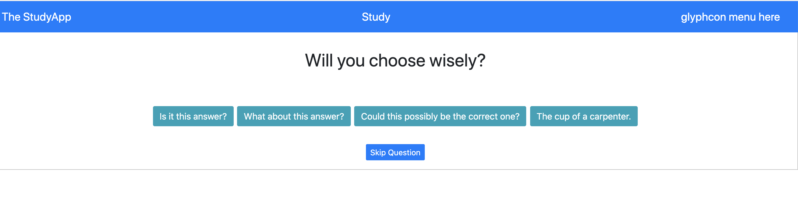
FlashCard

